Slide 1

Relationships within
EF Core
Part One: Defining Simple Relationships

Slide 2

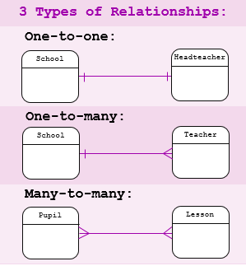
RECAP – Relationships within Databases
There are 3 Fundamental forms of relationships that can exist within databases:
  In a one-to-many relationship, the foreign key is defined on the table that represents the many end of the relationship.
  A many-to-many relationship involves defining a third table (called a junction or join table), whose primary key is composed of the foreign keys from both related tables.
  In a one-to-one relationship, the primary key acts additionally as a foreign key and there is no separate foreign key column for either table.
Notes:
Notes to presenter:
Description of what you learned in your own words on one side.
Include information about the topic
Details about the topic will also be helpful here.
Tell the story of your learning experience. Just like a story there should always be a beginning, middle and an end.
On the other side, you can add a graphic that provides evidence of what you learned.
Feel free to use more than one slide to reflect upon your process. It also helps to add some video of your process.

Slide 3
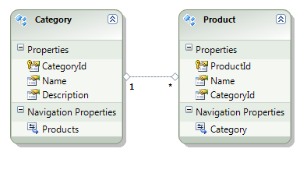
Implementing Relationships within EF Core
PART ONE : It’s all about Navigation
When utilizing the Code-First Approach in Entity Framework Core, we first define Navigation Properties in our code to provide a means to navigate an association between two entity types.
Every object can have a navigation property for each relationship in which it participates.
Notes:
Notes to presenter:
Description of what you learned in your own words on one side.
Include information about the topic
Details about the topic will also be helpful here.
Tell the story of your learning experience. Just like a story there should always be a beginning, middle and an end.
On the other side, you can add a graphic that provides evidence of what you learned.
Feel free to use more than one slide to reflect upon your process. It also helps to add some video of your process.

Slide 4
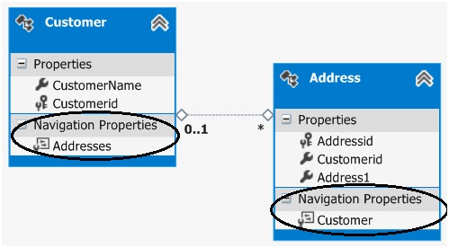
Navigating Relationships using EF Core
Navigation properties allow navigation / management of relationships in both directions, returning either a reference object (if the multiplicity is either one or zero-or-one) or a collection (if the multiplicity is many).
  You may choose to have one-way navigation - in which case you define the navigation property on only one of the types that participates in the relationship and not on both.

Slide 5
Implementing Relationships within EF Core
PART TWO : It’s all about the Key 🔑
It is also highly recommended to include properties in the model that map to the Foreign Keys stored within the database (but not required).
  (TLDR: What this means is that you can define relationships in several ways. This won’t make those different forms equivalent.) We will explore implementation of relationships each way and focus on the shortcomings of specific approaches.
  If we do not implement these Foreign Keys, this doesn’t prevent EF Core from having its own – they are just inaccessible to us (these are referred to as Shadow Keys 🗝)
  Note, that when working with 1-to-1 or 1-to-0..1 relationships, there is no separate foreign key column - the Primary Key property also acts as the Foreign Key and is always included in the model
  (You will still see the FK definition within your migration 👀)

Slide 6

!! CONVENTION ALERT !!
This Demo is show-casing several distinct Implicit Conventions
✔
1) Determining Relationship Type(s) via Model Properties
3
2
2) Mapping Relationships via Model Property Name/Type
1
3) Discovering Foreign Key Property based upon Name/Type
Notes:
Notes to presenter:
What steps will you be taking as a result of this learning experience?
Did you learn from any failed experiences? How will you do things differently?
What advice will you give to others so they can learn from your experiences?
How can you share what you learned with a real-world audience?
Some examples of next steps might be:
After delivering my first persuasive presentation, I am thinking about joining the debate team.
After making my first film, I’m considering entering it in our school film festival or local film festival.
After connecting with this career expert, I’d like to do some research on that career field because it sounds interesting to me.
This SmartArt allows you add images and text to help outline your process. If a picture is worth a thousand words, then pictures and words should help you communicate this reflection on learning perfectly! You can always click on Insert>SmartArt to change this graphic or select the graphic and click on the Design contextual menu to change the colors.
Feel free to use more than one slide to share your next steps. It also helps to add some video content to explain your message.

Slide 7
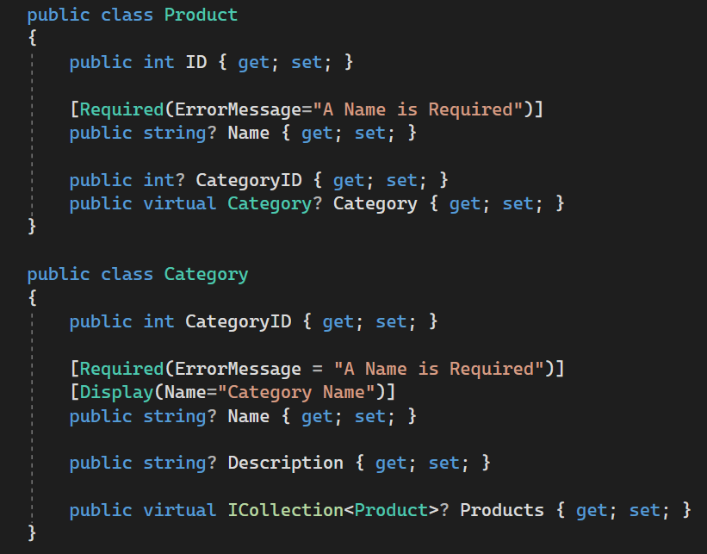
EXAMPLE IMPLEMENTATION
Product / Category
Notice that the Entity Category holds the collection of Products since it is the ‘one’ or ‘parent’ side of the relationship.
A Product Entity holds a navigation property containing a reference to the Category it is a part of since it is on the ‘many’ or ‘child’ side
  Also notice the Foreign Key (CategoryId)

Slide 8

Virtual
ICollection
When a navigation property is defined as virtual, it can take advantage of certain Entity Framework functionality.
The most common is Lazy-Loading. Lazy-Loading is a nice feature of ORMs that allows dynamic-access to related data from a model.
Many Microsoft examples demonstrate ICollection for returning a collection of objects
Navigation properties that represent collections MUST implement ICollection (we can either allow EF Core to choose the concrete class, or define our own)
List will also work fine (and can be better)- know why?
  ICollection is an interface, List is a class that implements ICollection
  ICollection will allow greater flexibility for the type of collection and has less overhead
  If you want to iterate through and modify a collection, ICollection is fine.
  If you want to iterate, modify, and sort - then you should use List. List has more overhead … but also more functionality.
Notes:
Notes to presenter:
What was important about this learning experience?
How is it relevant to your course, yourself, or your society or community?
Why is this significant?
This SmartArt allows you add images and text to help outline your process. If a picture is worth a thousand words, then pictures and words should help you communicate this reflection on learning perfectly! You can always click on Insert>SmartArt to change this graphic or select the graphic and click on the Design contextual menu to change the colors.

Slide 9

Once our Models are defined…
1) Generate Migrations
2) Apply DB Changes
01
04
02
03
4) Run ASP.NET Project
3) Generate Controllers/Views
Notes:
Notes to presenter:
What did you think at first?
What obstacles did you encounter along the way?
How did you overcome those obstacles?
What images can you add to support your process?
This SmartArt allows you add images and text to help outline your process. If a picture is worth a thousand words, then pictures and words should help you communicate this reflection on learning perfectly! You can always click on Insert>SmartArt to change this graphic or select the graphic and click on the Design contextual menu to change the colors.
Feel free to use more than one slide to reflect upon your process. It also helps to add some video of your process.

Slide 10
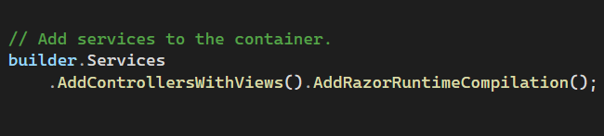
Hot Reloading / Runtime Compilation
It’s a difficult choice
When we create our project initially, the Wizard provides Hot Reloading to manage changes to the Razor Layout / Views without restarting the Server environment.
There is a different route to use – we can install the NuGet package Razor.RuntimeCompilation, which will automatically reload resources as they are modified during runtime – and will be used for future requests.
Be aware – The Razor Runtime Compilation package will disable the Hot Reloading feature for your project (and should also only be used for development – not Production Environments)
MORE INFO:
https://docs.microsoft.com/en-us/aspnet/core/mvc/views/view-compilation?view=aspnetcore-6.0
https://learn.microsoft.com/en-us/aspnet/core/test/hot-reload?view=aspnetcore-6.0

Slide 11
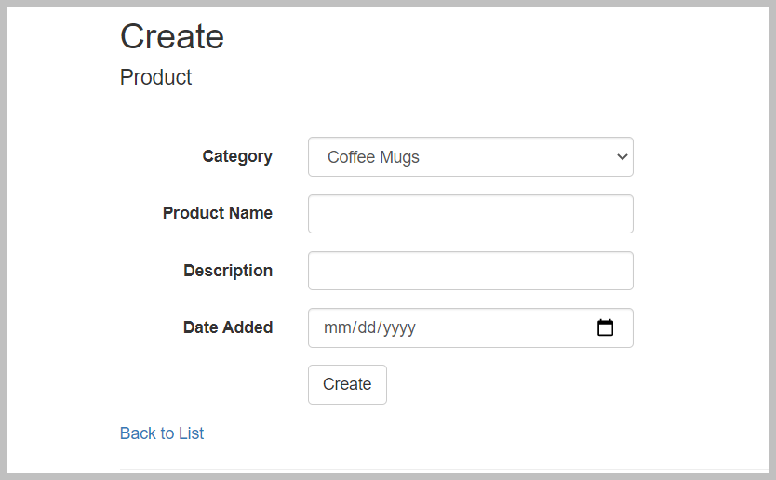
Data-bound SELECT Lists
When we create a New Product record, we need to also associate this record to one of the Categories that exists.
To simplify this process, the Scaffolding wizard has generated Controller/View implementation(s) that make use of Drop-Down Lists (also known as Select Lists)
Let’s review this implementation

Slide 12
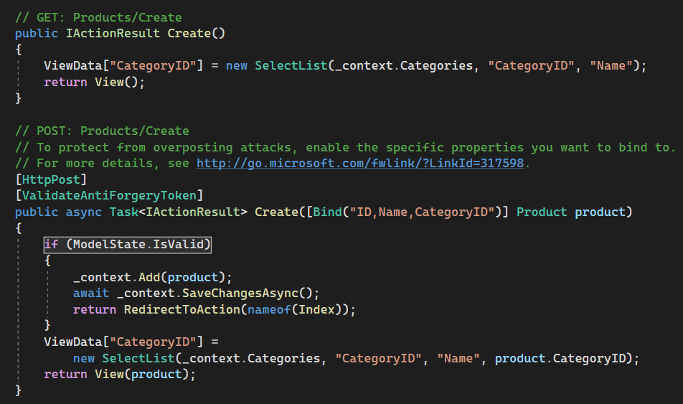
Product
Controller Implementation
The SelectList class that the code is using represents the data required to build a drop-down list of categories when we create products:
  The first parameter to the constructor specifies the items to place in the list (categories).
  The second parameter is the name of the property containing the value to use when the user selects a specific item (a key value, like 7).
  The third parameter is the text to display for each item (in this case “Name”).
  Finally, the fourth parameter contains the value of the initially selected item.
DataValueField
DataTextField
Currently Selected Id

Slide 13
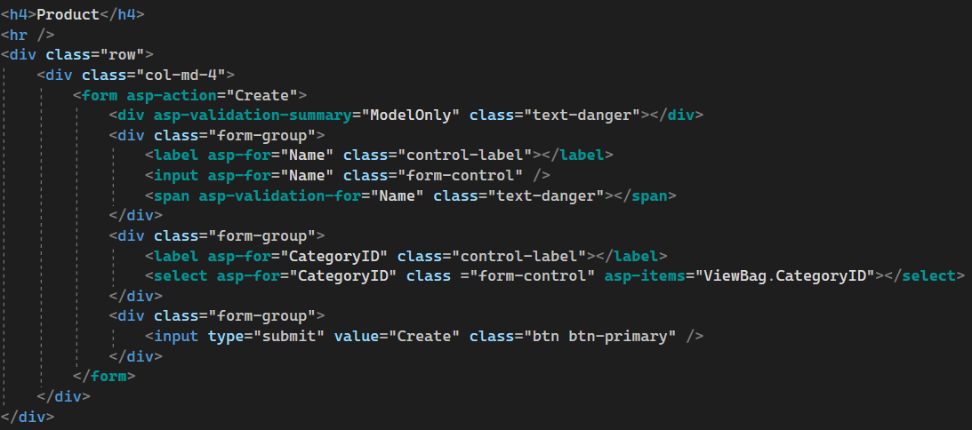
Product
View (Create)
Notice that the <Select> helper is using the CategoryId that was specified when we stored the SelectList in the viewbag in the previous example

Slide 14
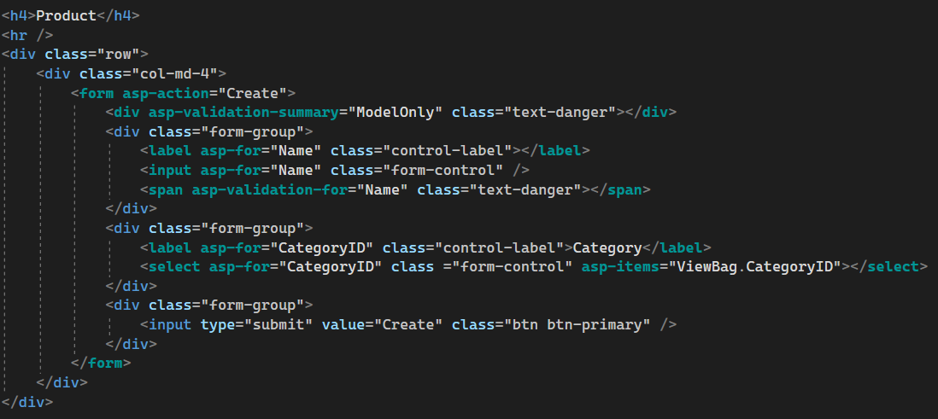
Displaying Category instead of CategoryID
Provide value for the <Label> element
Do NOT change these

Slide 15
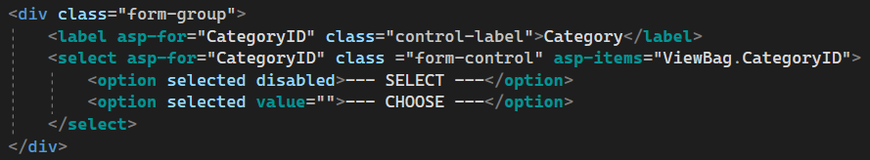
One last thing………
Our Relationship is Optional. How can we set no value?
Each of these options is for a different Use Case:
  Disabled cannot be selected again once focus changes
  Value=“” is used to provide no value for the option (if allowed)

